Slide 1
DOORSTEP DIAGNOSTICS
NAME: Dihan pathan
ID: 011172050
NAME: Azizul Hakim Khan Adnan
ID: 011163028
NAME: Nargis Sultana
ID: 011152195

Slide 2
MOTIVATION
Many people cannot go for diagnostic tests because of the few reasons:
Old age
Being extremely sick
Traffic and lack of time
Waiting in long queues etc.
Our goal is to make diagnostic tests available at doorsteps; to make people able to have tests done from their homes.

Slide 3
General Feature
Order for the preferred medical tests through the website.
Samples collected by Trained Collectors from their homes.
Samples carried in specialized temperature controlled carriers and delivered to selected Hospitals and Diagnostic centers
Results delivered immediately to the patient’s home when done.

Slide 4
Unique Feature
COVID-19!!
If anyone have doubts of having symptoms of COVID-19 (corona virus) which is an international crisis right now, they can avail our EMERGENCY SERVICE and a specialized team certified by ICDDRB and IEDCR will reach them for the COVID-19 test.

Slide 5
BREAKDOWN
1. User Interface Design.
2. Data Structure Finalization.
3. Prepare Database.
4. Develop the Frontend
5. Coding the backend.
6. Integration and adjustment of Frontend, Backend, & DB.
8. Bug fixing and ready for deployment.
7. Testing & Feedback Collection.
WEEK -01: Preparation Phase
WEEK -02: Development Phase
WEEK -03: Finalization

Slide 6
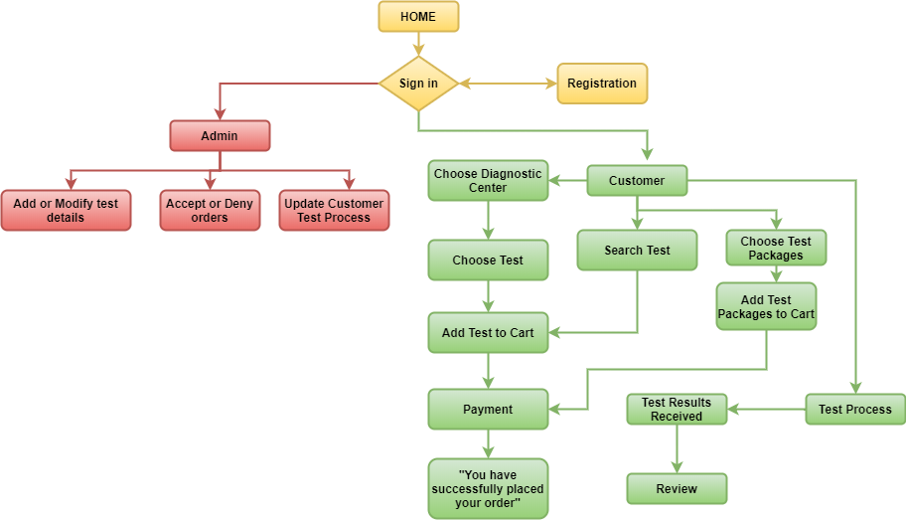
FLOW CHART
No account

Slide 7
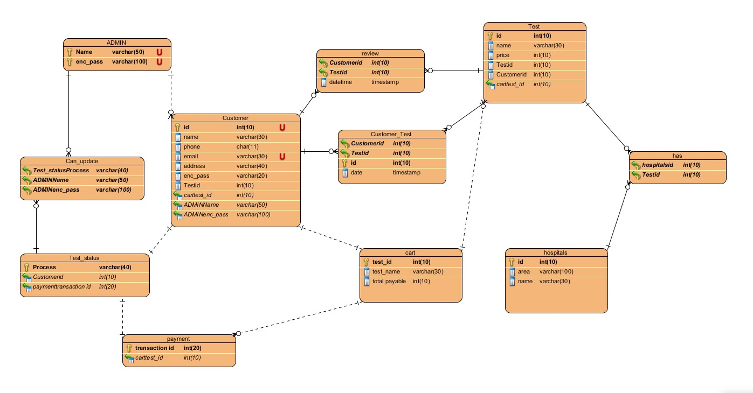
ER DIAGRAM

Slide 8
FUTURE PLAN
To be able to detect some big diseases like
Cancer
AIDS
To expand the service around whole Bangladesh including rural places.

Slide 9
THANK YOU!
Cheers to a good health!

